Slide 1


A satellite with homespun electronics
April 2017

Slide 2
INDEX
Problem
Solution
Project Philosophy
Team
Achievements
Tools
Roadmap
Current I+D process

Slide 3
INDEX
Problem
Solution
Project Philosophy
Team
Achievements
Tools
Roadmap
Current I+D process

Slide 4
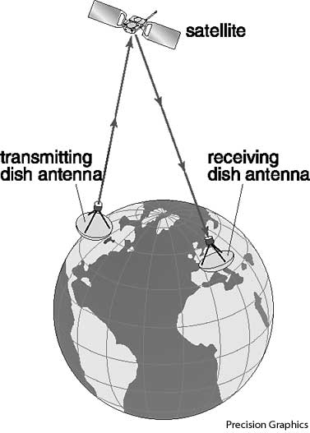
PROBLEM
Classic Satellite Communications
usual problems
High costs
Unaccessible
Private owners
Low bandwidth
Maintenance

Slide 5
INDEX
Problem
Solution
Project Philosophy
Team
Achievements
Tools
Roadmap
Current I+D process

Slide 6
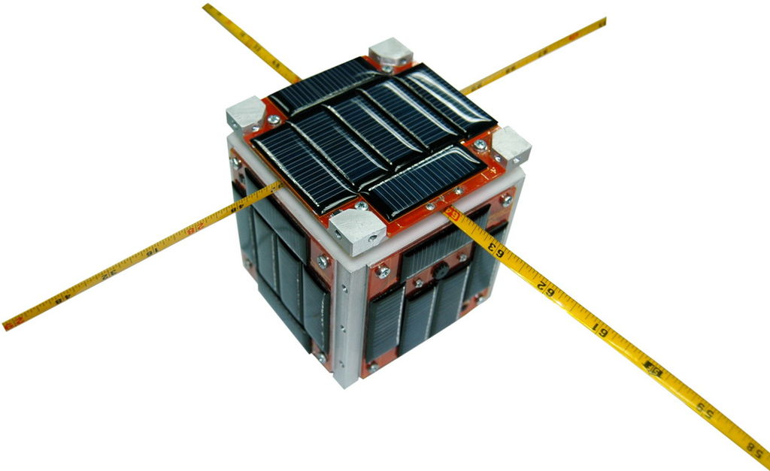
SOLUTION
http://www.cubesat.org/

Slide 7
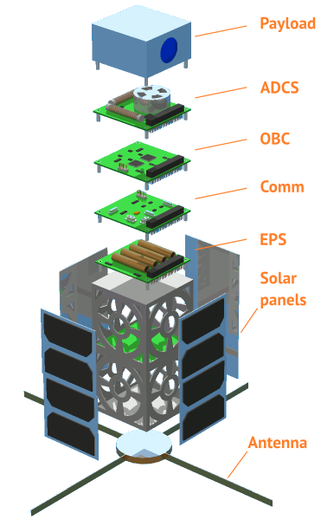
SOLUTION

Slide 8
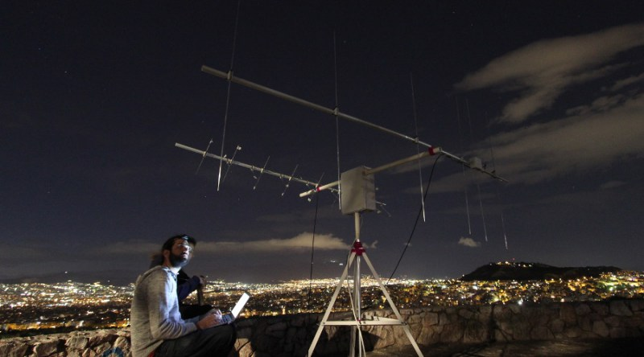
SOLUTION
https://satnogs.org/

Slide 9
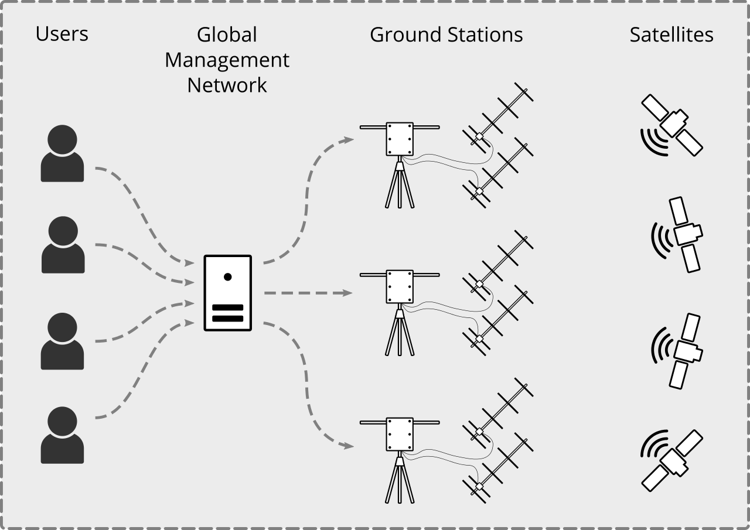

SOLUTION

Slide 10
INDEX
Problem
Solution
Project Philosophy
Team
Achievements
Tools
Roadmap
Current I+D process

Slide 11


PROJECT PHILOSOPHY

Slide 12
INDEX
Problem
Solution
Project Philosophy
Team
Achievements
Tools
Roadmap
Current I+D process

Slide 13
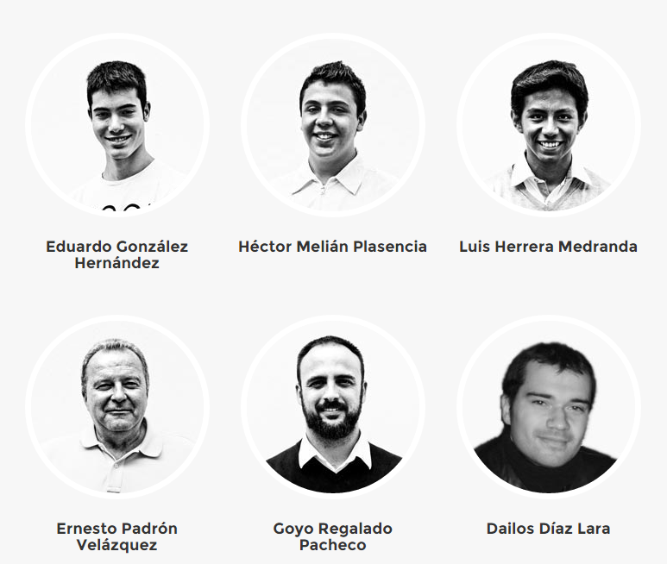
TEAM

Slide 14


TEAM

Slide 15
INDEX
Problem
Solution
Project Philosophy
Team
Achievements
Tools
Roadmap
Current I+D process

Slide 16
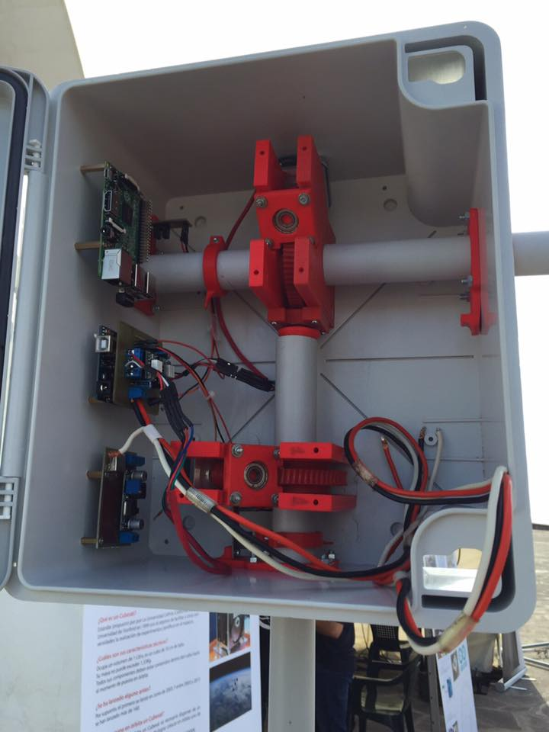
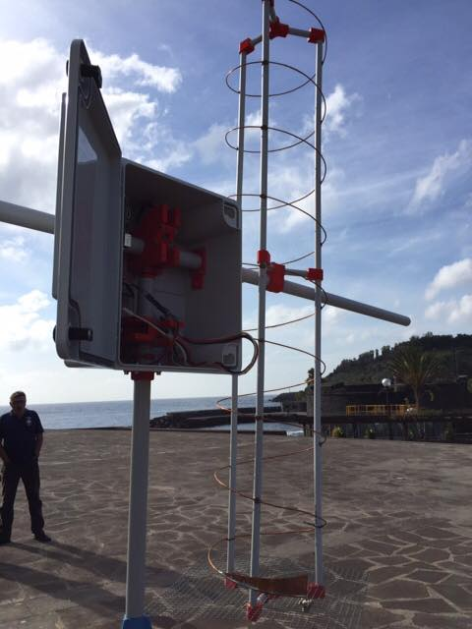
ACHIEVEMENTS
RADIO STATION (SATELLITE TRACKER)

Slide 17
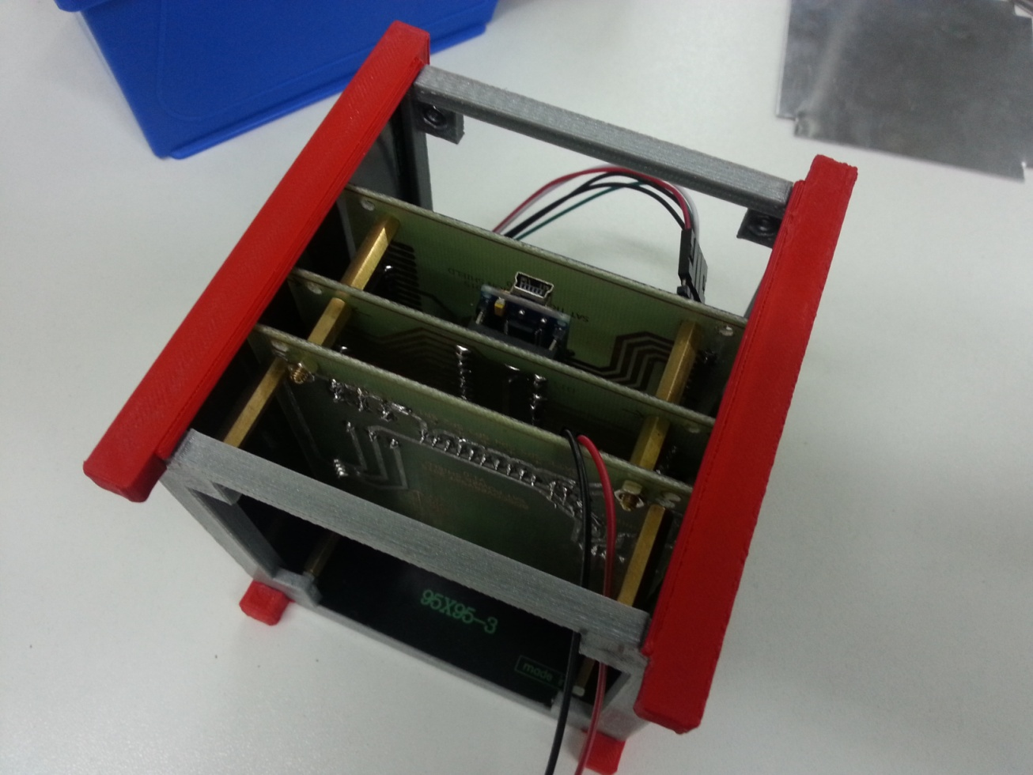
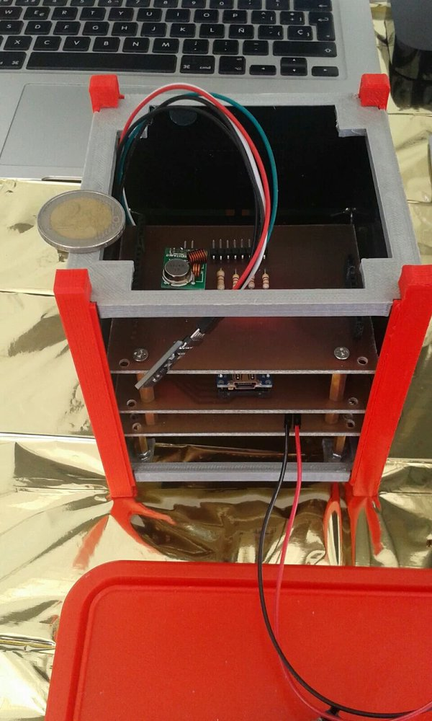
ACHIEVEMENTS
SATELLITE
MARK I – ALPHA 1

Slide 18
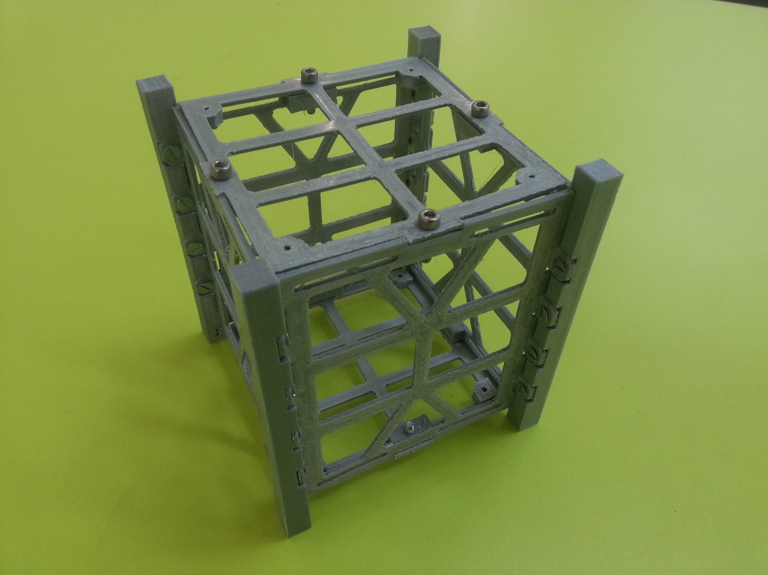
ACHIEVEMENTS
SATELLITE
MARK I – ALPHA 2

Slide 19
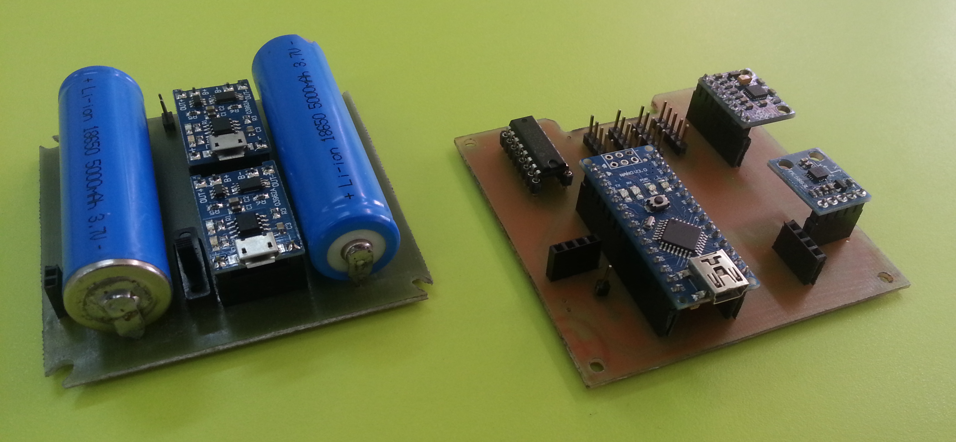
ACHIEVEMENTS
SATELLITE
MARK I – ALPHA 2

Slide 20
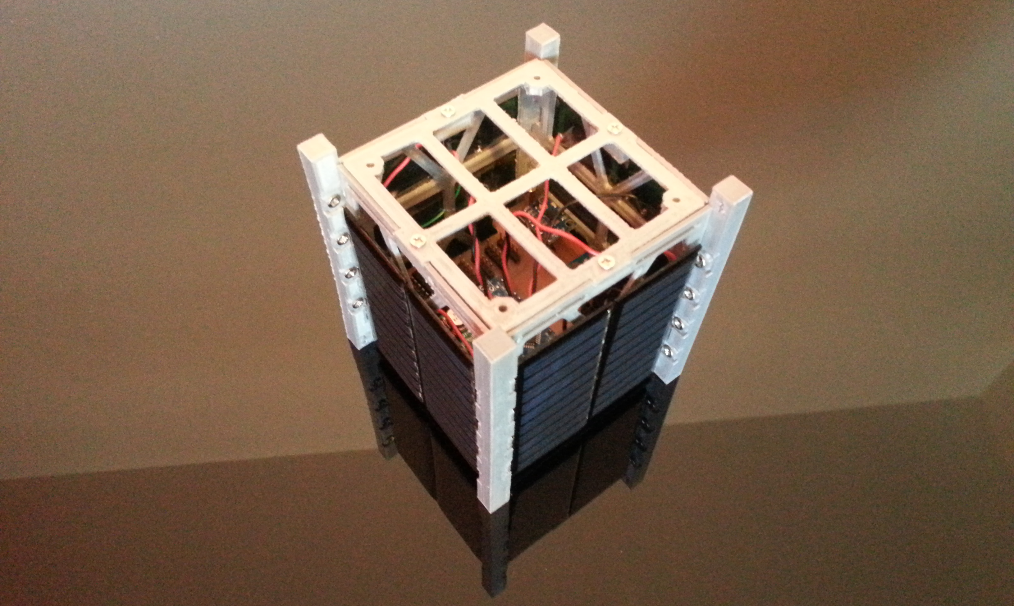
ACHIEVEMENTS
SATELLITE
MARK I – ALPHA 2

Slide 21
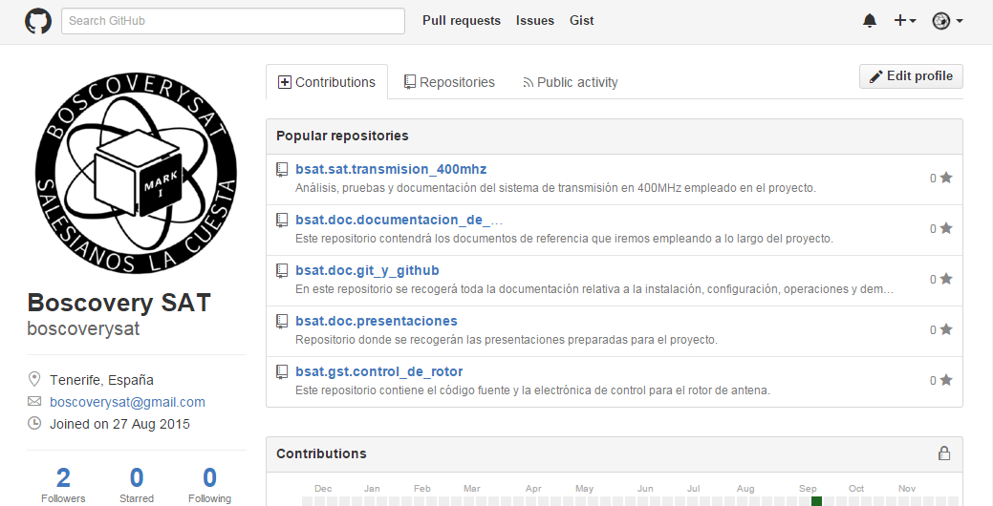
ACHIEVEMENTS
DOCUMENTATION (GitHub Repository)

Slide 22
INDEX
Problem
Solution
Project Philosophy
Team
Achievements
Tools
Roadmap
Current I+D process

Slide 23


TOOLS
COMMUNICATION
Gmail
Whatsapp

Slide 24


TOOLS
TEAMWORK
Google Drive
GitHub

Slide 25


TOOLS
MANAGEMENT
Google Calendar
Trello

Slide 26














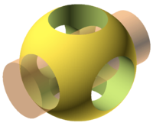

TOOLS
DEVELOPMENT (SW & HW)
Editors and IDEs
Prog. Languages
Version Control
Operative Systems
Satellite & Tracker

Slide 27
INDEX
Problem
Solution
Project Philosophy
Team
Achievements
Tools
Roadmap
Current I+D process

Slide 28
ROADMAP
It is a long time project
Apr
May
Jun
Jul
Aug
Sep
Oct
Nov
Dec
2016
Jan
Dec
2018
2015
2017
Jan
Dec
Jan
Jun

Slide 29
ROADMAP
Apr
May
Jun
Jul
Aug
Sep
Oct
Nov
Dec
2016
Jan
Dec
2018
2015
2017
Jan
Dec
Jan
Jun

Slide 30
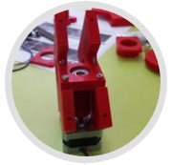
ROADMAP
San Juan Bosco
La Cuesta School
Projects Week 2015
Satellite Tracker
Apr
May
Jun
Jul
Aug
Sep
Oct
Nov
Dec
2016
Jan
Dec
2018
2015
2017
Jan
Dec
Jan
Jun

Slide 31
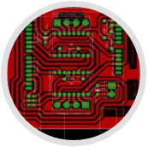
ROADMAP
San Juan Bosco
La Cuesta School
Projects Week 2015
Satellite Tracker
Satellite Tracker
First systems development
Apr
May
Jun
Jul
Aug
Sep
Oct
Nov
Dec
2016
Jan
Dec
2018
2015
2017
Jan
Dec
Jan
Jun

Slide 32
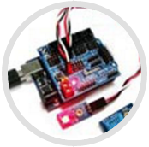
ROADMAP
San Juan Bosco
La Cuesta School
Projects Week 2015
Satellite Tracker
Satellite Tracker
First systems development
Satellite
Orbital sensors testing
Apr
May
Jun
Jul
Aug
Sep
Oct
Nov
Dec
2016
Jan
Dec
2018
2015
2017
Jan
Dec
Jan
Jun

Slide 33
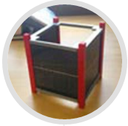
ROADMAP
San Juan Bosco
La Cuesta School
Projects Week 2015
Satellite Tracker
Satellite Tracker
First systems development
Satellite
Orbital sensors testing
Apr
May
Jun
Jul
Aug
Sep
Oct
Nov
Dec
2016
Jan
Dec
2018
2015
2017
Jan
Dec
Jan
Jun
Satellite
Alpha 1 release

Slide 34

ROADMAP
San Juan Bosco
La Cuesta School
Projects Week 2015
Satellite Tracker
Satellite Tracker
First systems development
Satellite
Orbital sensors testing
Apr
May
Jun
Jul
Aug
Sep
Oct
Nov
Dec
2016
Jan
Dec
2018
2015
2017
Jan
Dec
Jan
Jun
Satellite
Alpha 1 released
Phase #1 – Project definition and first developments.
Canary Islands
Science Weeks

Slide 35
ROADMAP
San Juan Bosco
La Cuesta School
Projects Week 2015
Satellite Tracker
Satellite Tracker
First systems development
Satellite
Orbital sensors testing
Apr
May
Jun
Jul
Aug
Sep
Oct
Nov
Dec
2016
Jan
Dec
2018
2015
2017
Jan
Dec
Jan
Jun
Satellite
Alfa 1 release
Phase #1 – Project definition and first developments.
Phase #2 – Payload development and testing.
Canary Islands
Science Weeks

Slide 36
ROADMAP
2016

Slide 37

ROADMAP
Jan
Feb
Mar
Apr
May
Jun
Jul
Aug
Sep
Oct
Nov
Dec
2017
Jan
Dec
2016
2018
Jan
Dec
Research & Documentation
Phase #1 – Project definition and first developments.
Phase #2 – Payload development and testing.

Slide 38

ROADMAP
III Science and
Technology
National Award
St. Louis University
Madrid
Jan
Feb
Mar
Apr
May
Jun
Jul
Aug
Sep
Oct
Nov
Dec
2017
Jan
Dec
2016
2018
Jan
Dec
Research & Documentation
Phase #1 – Project definition and first developments.
Phase #2 – Payload development and testing.

Slide 39
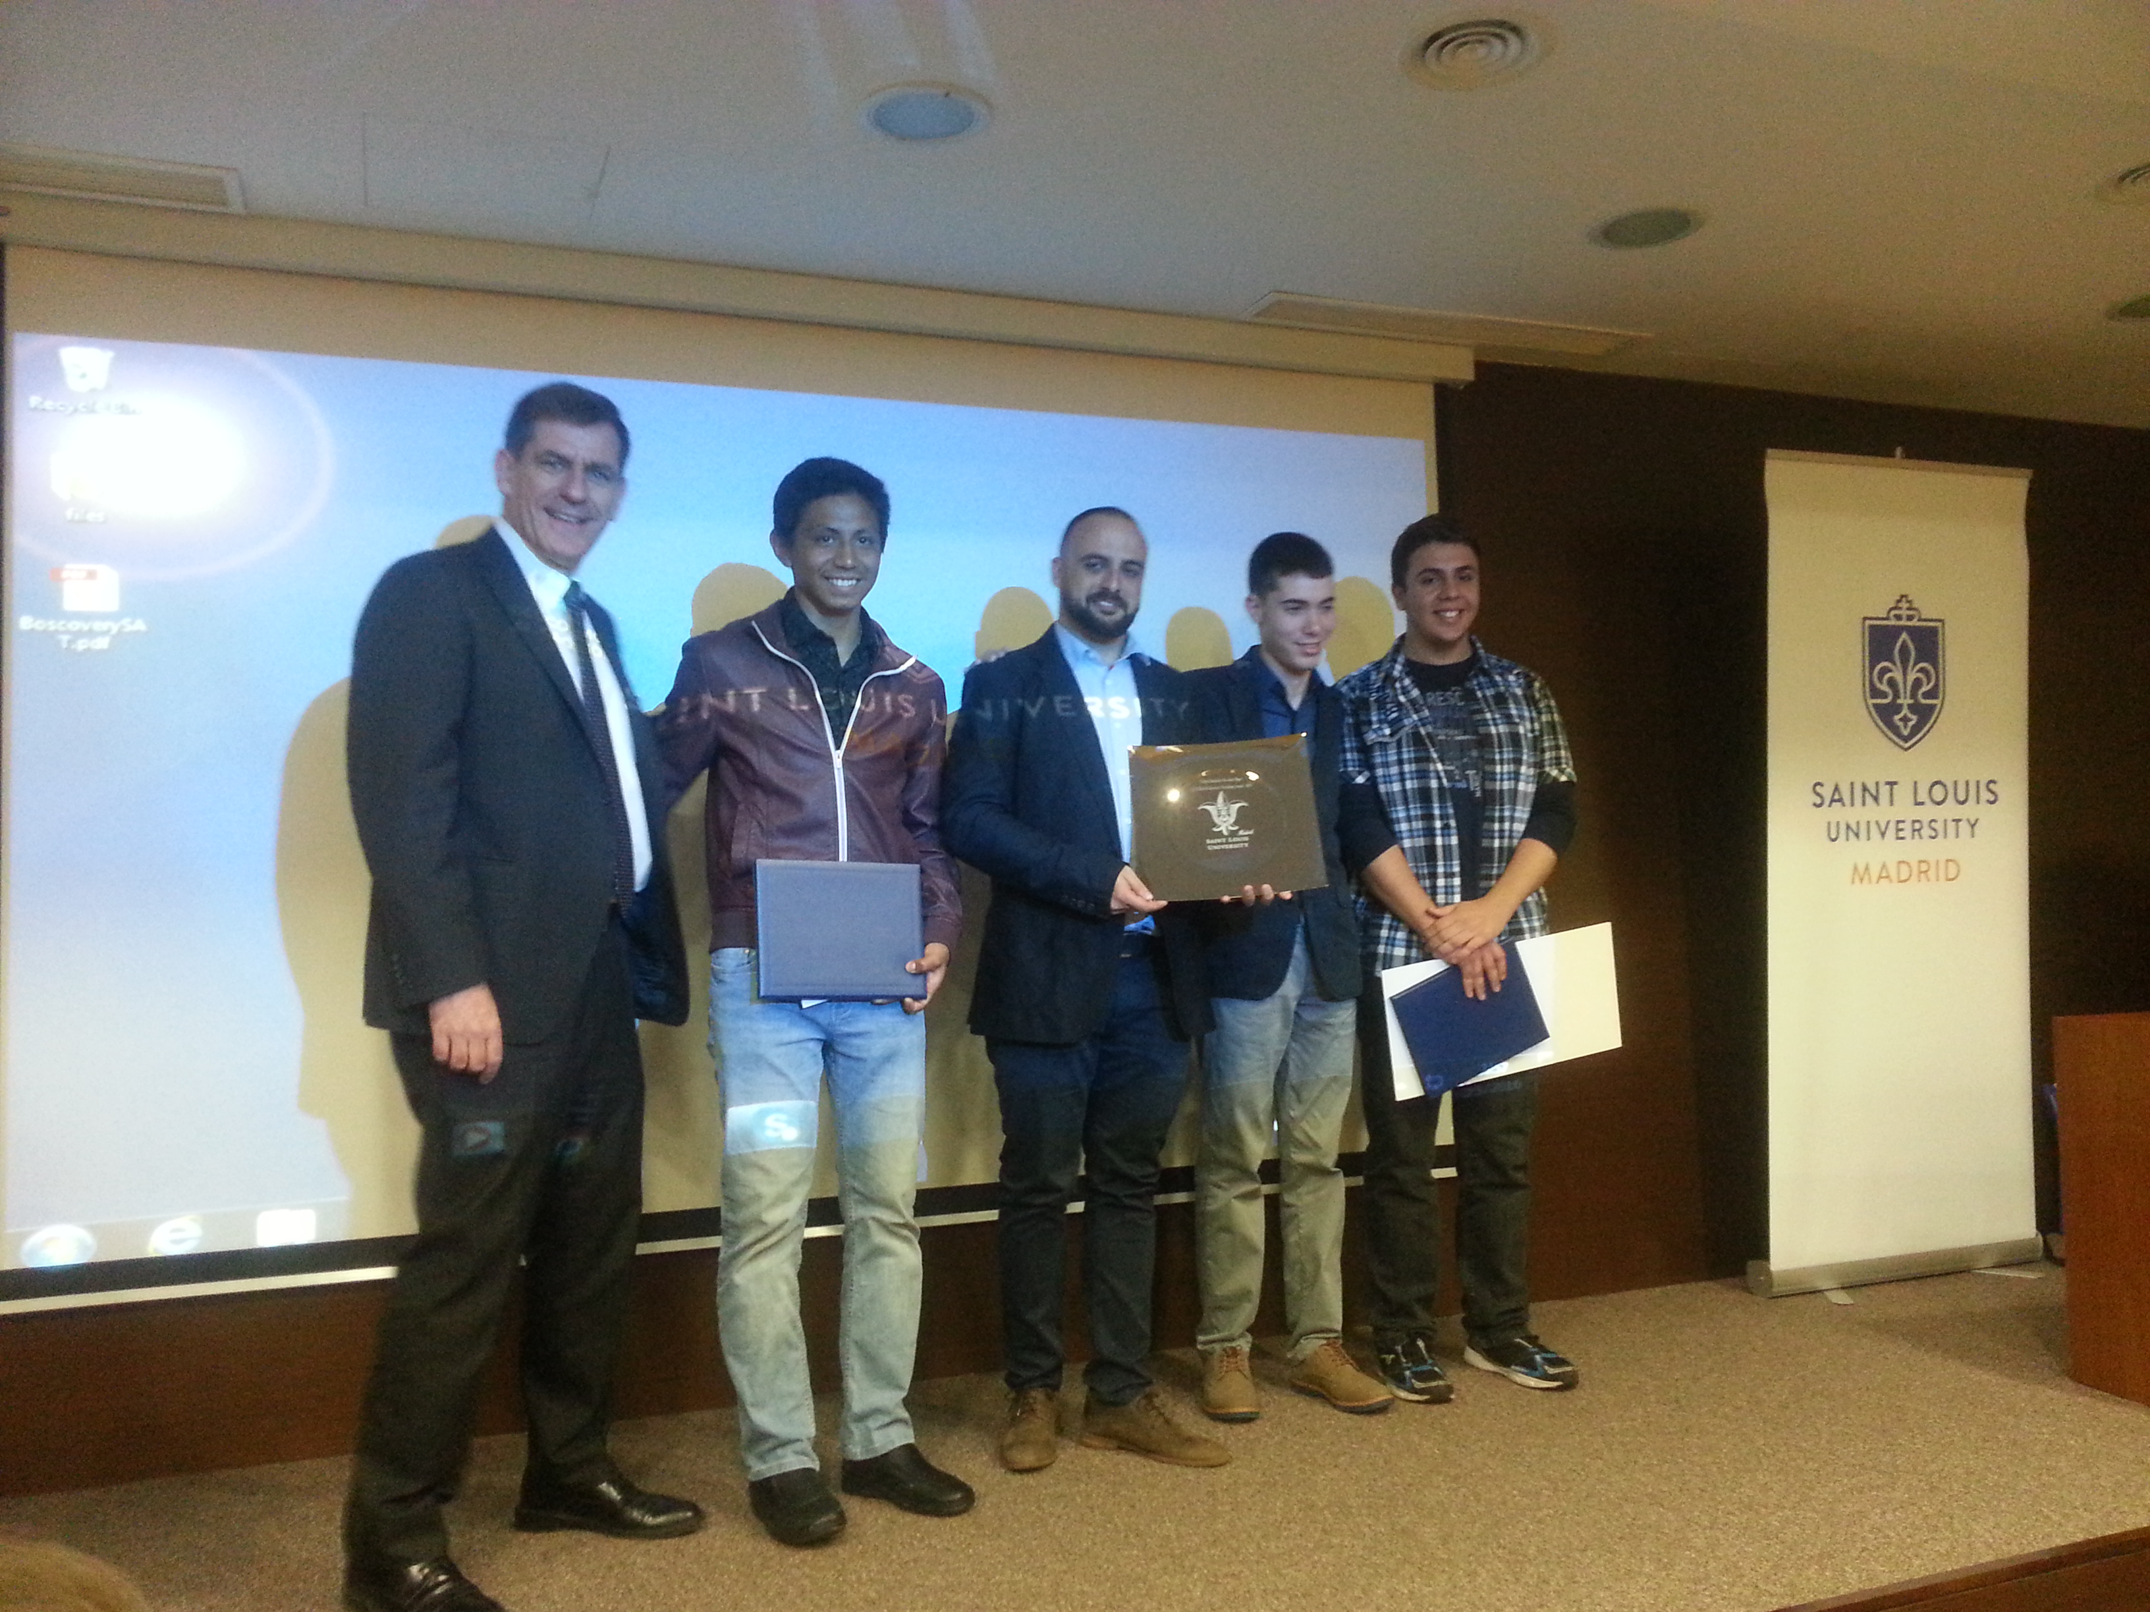
ROADMAP

Slide 40
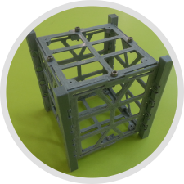
ROADMAP
III Science and
Technology
National Award
St. Louis University Madrid
Jan
Feb
Mar
Apr
May
Jun
Jul
Aug
Sep
Oct
Nov
Dec
2017
Jan
Dec
2016
2018
Jan
Dec
Research & Documentation
Phase #1 – Project definition and first developments.
Phase #2 – Payload development and testing.
Structure &
Electronics design
3D printed prototype
and shields

Slide 41
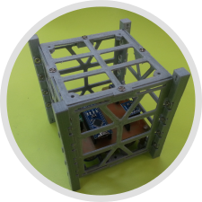
ROADMAP
San Juan Bosco
La Cuesta School
Projects Week 2016
Satellite Structure Test
III Science and
Technology
National Award
St. Louis University Madrid
Jan
Feb
Mar
Apr
May
Jun
Jul
Aug
Sep
Oct
Nov
Dec
2017
Jan
Dec
2016
2018
Jan
Dec
Research & Documentation
Phase #1 – Project definition and first developments.
Phase #2 – Payload development and testing.
Structure &
Electronics design
3D printed prototype
and shields

Slide 42
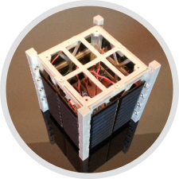
ROADMAP
Satellite
Alpha 2 released
San Juan Bosco
La Cuesta School
Projects Week 2016
Satellite Structure Test
III Science and
Technology
National Award
St. Louis University Madrid
Jan
Feb
Mar
Apr
May
Jun
Jul
Aug
Sep
Oct
Nov
Dec
2017
Jan
Dec
2016
2018
Jan
Dec
Research & Documentation
Phase #1 – Project definition and first developments.
Phase #2 – Payload development and testing.
Structure &
Electronics design
3D printed prototype
and shields

Slide 43

ROADMAP
Satellite
Alpha 2 released
TED^{x} La Laguna
The dream of creating a satellite
San Juan Bosco
La Cuesta School
Projects Week 2016
Satellite Structure Test
III Science and
Technology
National Award
St. Louis University Madrid
Jan
Feb
Mar
Apr
May
Jun
Jul
Aug
Sep
Oct
Nov
Dec
2017
Jan
Dec
2016
2018
Jan
Dec
Research & Documentation
Phase #1 – Project definition and first developments.
Phase #2 – Payload development and testing.
Structure &
Electronics design
3D printed prototype
and shields

Slide 44

ROADMAP
Satellite
Alpha 2 released
TED^{x} La Laguna
The dream of creating a satellite
San Juan Bosco
La Cuesta School
Projects Week 2016
Satellite Structure Test
Canary Islands
Science Weeks
III Science and
Technology
National Award
St. Louis University Madrid
Jan
Feb
Mar
Apr
May
Jun
Jul
Aug
Sep
Oct
Nov
Dec
2017
Jan
Dec
2016
2018
Jan
Dec
Research & Documentation
Phase #1 – Project definition and first developments.
Phase #2 – Payload development and testing.
Structure &
Electronics design
3D printed prototype
and shields

Slide 45
ROADMAP
Satellite
Alpha 2 released
TED^{x} La Laguna
The dream of creating a satellite
San Juan Bosco
La Cuesta School
Projects Week 2016
Satellite Structure Test
Canary Islands
Science Weeks
III Science and
Technology
National Award
St. Louis University Madrid
Jan
Feb
Mar
Apr
May
Jun
Jul
Aug
Sep
Oct
Nov
Dec
2017
Jan
Dec
2016
2018
Jan
Dec
Research & Documentation
Phase #1 – Project definition and first developments.
Phase #2 – Payload development and testing.
Structure &
Electronics design
3D printed prototype
and shields
Phase #3 – Official tests and certifications.

Slide 46
ROADMAP
2017

Slide 47

ROADMAP
Research
Solar power &
battery recharging systems
Jan
Feb
Mar
Apr
May
Jun
Jul
Aug
Sep
Oct
Nov
Dec
2018
Jan
Dec
2017
2019
Jan
Dec
Phase #1 – Project definition and first developments.
Phase #2 – Payload development and testing.
Phase #3 – Official tests and certifications.

Slide 48
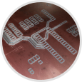
ROADMAP
Research
Solar power &
battery recharging systems
New development tools
CAD Software,
CNC machines, etc.
Jan
Feb
Mar
Apr
May
Jun
Jul
Aug
Sep
Oct
Nov
Dec
2018
Jan
Dec
2017
2019
Jan
Dec
Phase #1 – Project definition and first developments.
Phase #2 – Payload development and testing.
Phase #3 – Official tests and certifications.

Slide 49
ROADMAP
Research
Solar power &
battery recharging systems
New development tools
CAD Software,
CNC machines, etc.
Jan
Feb
Mar
Apr
May
Jun
Jul
Aug
Sep
Oct
Nov
Dec
2018
Jan
Dec
2017
2019
Jan
Dec
Phase #1 – Project definition and first developments.
Phase #2 – Payload development and testing.
Phase #3 – Official tests and certifications.

Slide 50
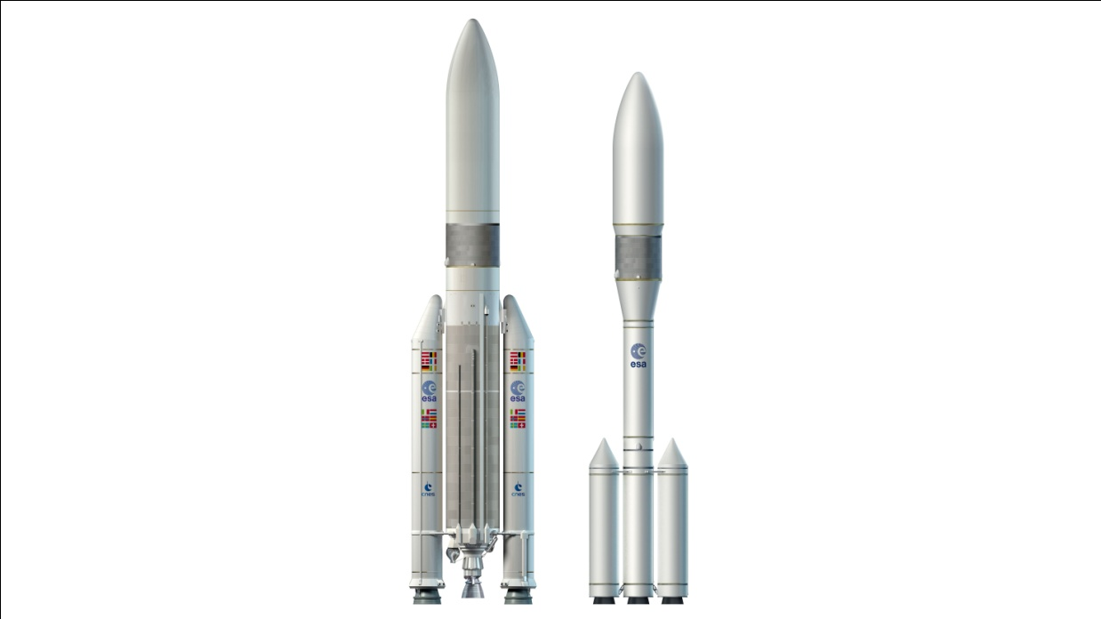
ROADMAP
Research
Solar power &
battery recharging systems
New development tools
CAD Software,
CNC machines, etc.
Jan
Feb
Mar
Apr
May
Jun
Jul
Aug
Sep
Oct
Nov
Dec
2018
Jan
Dec
2017
2019
Jan
Dec
Phase #1 – Project definition and first developments.
Phase #2 – Payload development and testing.
Phase #3 – Official tests and certifications.
Phase #4 – Satellite launching.

Slide 51
INDEX
Problem
Solution
Project Philosophy
Team
Achievements
Tools
Roadmap
Current I+D process

Slide 52
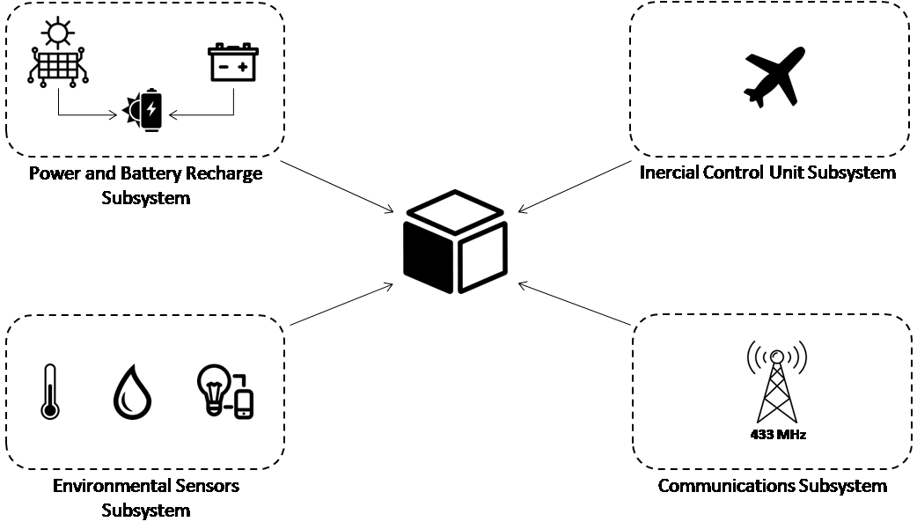
CURRENT I+D PROCESS

Slide 53
CURRENT I+D PROCESS

Slide 54







boscoverysat@gmail.com
@boscoverysat
boscoverysat
boscoverysat.github.com
BoscoverySAT

Slide 55
A satellite with homespun electronics
April 2017

Slide 56
Satellites' Orbits and Positioning

Slide 57

SATELLITES' ORBITS AND POSITIONING
Based on HEIGHTs
160 km
2.000 km
LOW EARTH ORBIT
(LEO)

Slide 58
SATELLITES' ORBITS AND POSITIONING
Based on HEIGHTs
160 km
2.000 km
LOW EARTH ORBIT
(LEO)
LOW EARTH ORBIT DATA:
Average speed:
7,8km/s (28.080km/h)
Average orbit time:
99 minutes
Usual deployments:
Scientific missions

Slide 59
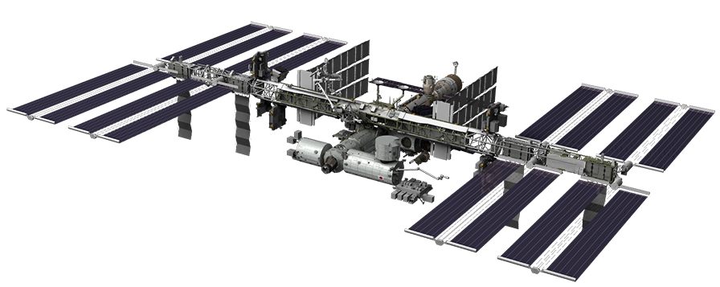
SATELLITES' ORBITS AND POSITIONING
Based on HEIGHTs
Missions deployed at LEO orbit
International Space Station

Slide 60
SATELLITES' ORBITS AND POSITIONING
Based on HEIGHTs
160 km
2.000 km
35.800 km
LEO
MIDDLE EARTH ORBIT
(MEO)

Slide 61
SATELLITES' ORBITS AND POSITIONING
Based on HEIGHTs
160 km
2.000 km
35.800 km
LEO
MIDDLE EARTH ORBIT
(MEO)
MIDDLE EARTH ORBIT DATA:
Average speed:
3,9km/s (14.040km/h)
Average orbit time:
12 - 24 hours
Usual deployments:
GPS (20.200km) and special use for regions tracking

Slide 62
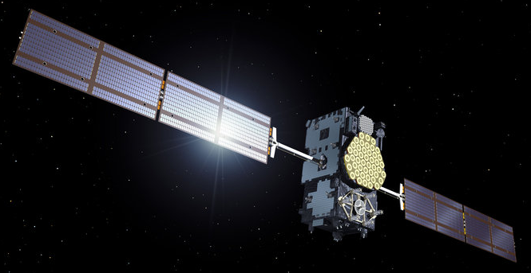
SATELLITES' ORBITS AND POSITIONING
Based on HEIGHTs
Missions deployed at MEO orbit
ESA Galileo GPS Satellite

Slide 63

SATELLITES' ORBITS AND POSITIONING
Based on HEIGHTs
160 km
2.000 km
35.800 km
384.000 km
Moon
LEO
MEO
HIGH EARTH ORBIT
(HEO)
Geosynchronous Orbit

Slide 64
SATELLITES' ORBITS AND POSITIONING
Based on HEIGHTs
160 km
2.000 km
35.800 km
384.000 km
Moon
LEO
MEO
HIGH EARTH ORBIT
(HEO)
Geosynchronous Orbit
MIDDLE EARTH ORBIT DATA:
Average speed:
3,08km/s (11.088km/h) = Earth's rotation speed
Average orbit time:
Years (geostationary orbit)
Usual deployments:
Communications and weather stellites

Slide 65
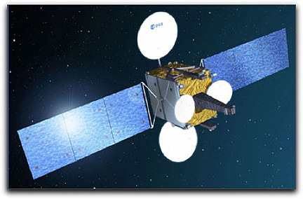
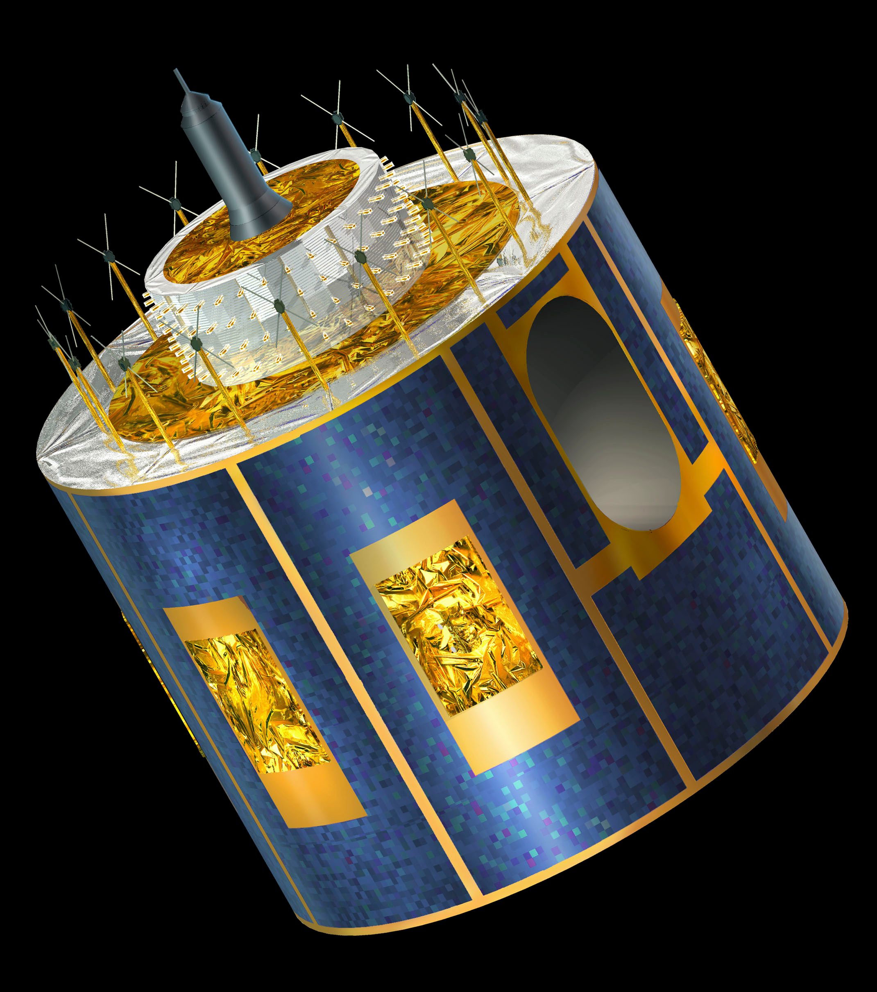
SATELLITES' ORBITS AND POSITIONING
Based on HEIGHTs
Missions deployed at HEO orbit
Hispasat AG1
Meteosat

Slide 66
Power and Battery Recharge Subsystem

Slide 67
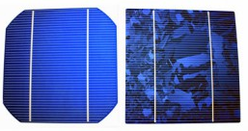
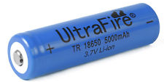
POWER AND BATTERY RECHARGE SUBSYSTEM
Facts
9,5 – 11 VDC/Side
50 – 60mA/Side
2 x 18650 Batt type
3,7V @ 5000mAh

Slide 68
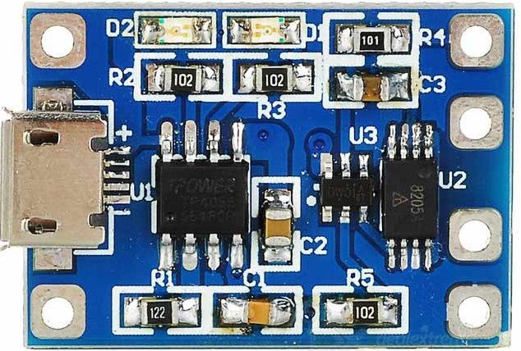
POWER AND BATTERY RECHARGE SUBSYSTEM
Facts
Fails
9,5 – 11 VDC/Side
50 – 60mA/Side
2 x TP4056
4,1V @ 1A
Battery Charger
2 x 18650 Batt type
3,7V @ 5000mAh

Slide 69
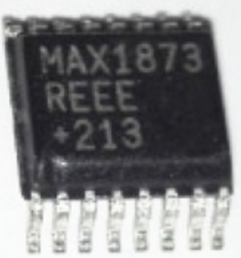
POWER AND BATTERY RECHARGE SUBSYSTEM
Facts
Fails
Researching
9,5 – 11 VDC/Side
50 – 60mA/Side
2 x TP4056
4,1V @ 1A
Battery Charger
MAX1873REEE
Up to 4 Li+ Batts
-40ºC to +85ºC
2 x 18650 Batt type
3,7V @ 5000mAh

Slide 70
Environmental Sensors Subsystem

Slide 71
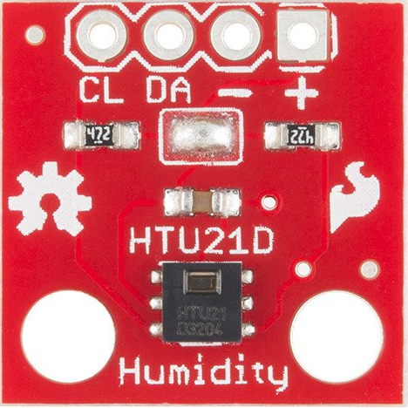
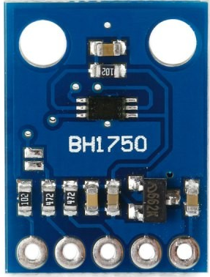
ENVIRONMENTAL SENSORS SUBSYSTEM
Facts
HTU21D
Temperature
Battery, Cockpit, Side 1 – 6, Control Unit
BH1750L
Light Intensity
Side 1 – 6

Slide 72
ENVIRONMENTAL SENSORS SUBSYSTEM
Facts
Issues
HTU21D
Temperature
Multiple I2C devices with the same address.
Battery, Cockpit, Side 1 – 6, Control Unit
BH1750L
Light Intensity
Side 1 – 6

Slide 73
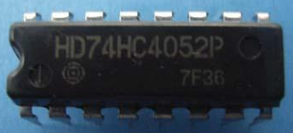
ENVIRONMENTAL SENSORS SUBSYSTEM
Facts
Issues
HTU21D
Temperature
Multiple I2C devices with the same address.
Battery, Cockpit, Side 1 – 6, Control Unit
Researching
Multiplexing SDA wire.
BH1750L
Light Intensity
Side 1 – 6
Dual CMOS 4-channel analog
multiplexer, demultiplexer.

Slide 74
Communications Subsystem

Slide 75

COMMUNICATIONS SUBSYSTEM
Facts
Telemetry & Configuration
UHF 430 – 440 MHz
Radio Communication
VHF 144 – 148 MHz

Slide 76
COMMUNICATIONS SUBSYSTEM
Facts
Issues
Telemetry & Configuration
Buffer overflow on packages transmission for telemetry and configuration.
UHF 430 – 440 MHz
Radio Communication
VHF 144 – 148 MHz

Slide 77
COMMUNICATIONS SUBSYSTEM
Facts
Issues
Telemetry & Configuration
Buffer overflow on packages transmission for telemetry and configuration.
UHF 430 – 440 MHz
Researching
Radio Communication
Error control by parity bits.
VHF 144 – 148 MHz
Antenna deploymen system.

Slide 78
Budget

Slide 79





TOTAL RESOURCES INVESTED UP TODAY
Electronics
190,00 €
3D Printing
75,00 €
Mechanical components
25,00 €
Other materials
30,00 €
TOTAL AMOUNT
320,00 €
Total spent time (aprox.)
1.790 h

Slide 80



DEPLOYMENT BUDGET
500,00 €
10.000,00 €
60.000,00 €
Unexpected expenses
2.500,00 €
TOTAL AMOUNT
73.000,00 €

Slide 81
Deployment environmental conditions

Slide 82

DEPLOYMENT ENVIRONMENTAL CONDITIONS
temperature
-157°C
120°C
https://science.nasa.gov

Slide 83
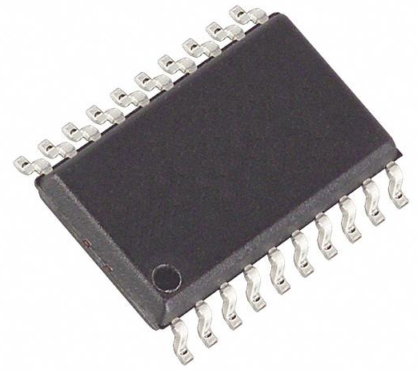
DEPLOYMENT ENVIRONMENTAL CONDITIONS
Temperature
electronics components
-40°C
( -157°C )
85°C
( 120°C )

Slide 84
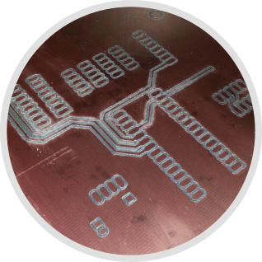
DEPLOYMENT ENVIRONMENTAL CONDITIONS
Temperature
printed circuits boards
-50°C
( -157°C )
140°C
( 120°C )
FR-4 – Glass reinforced epoxy composite
1 oz copper thickness

Slide 85

DEPLOYMENT ENVIRONMENTAL CONDITIONS
Temperature
soldering materials
-190°C
( -157°C )
183°C
( 120°C )
Sn60Pb40

Slide 86
Real deployed CubSat based projects on

Slide 87
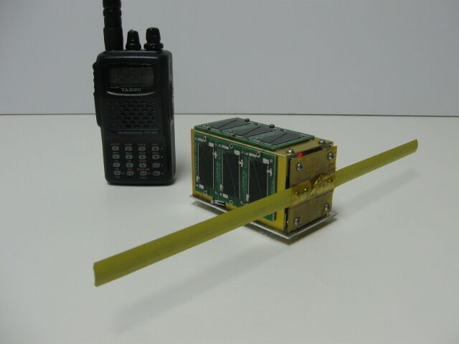
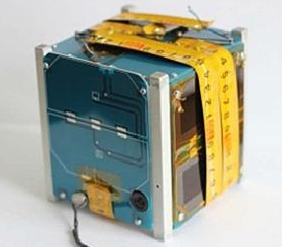
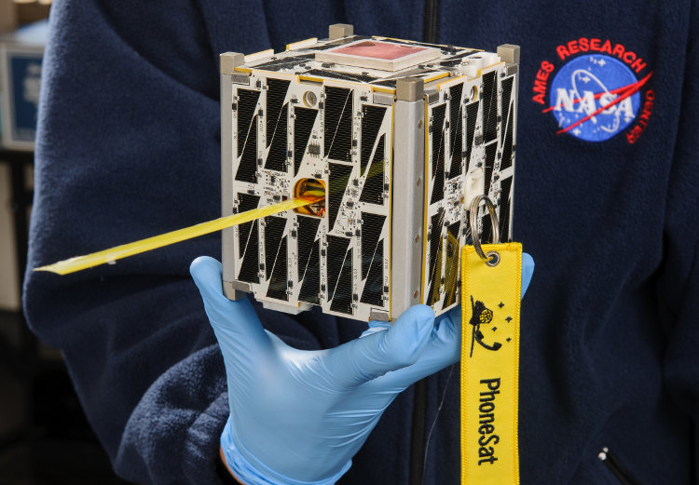
REAL DEPLOYED CUBSAT BASED PROJECTS ON
Maybe…
But we are not alone.

Slide 88



REAL DEPLOYED CUBSAT BASED PROJECTS ON
50$ Sat
Built by three amateur radio operators.
7 months in orbit.
Dniepper russian rocket.
www.50dollarsat.info

Slide 89
REAL DEPLOYED CUBSAT BASED PROJECTS ON
PicoDragon
Built by VNSC
(Vietnam National Satellite Center)
In orbit during 4 months.
ISS
https://vnsc.org.vn/en/projects/profile-of-the-picodragon-satellite/

Slide 90
REAL DEPLOYED CUBSAT BASED PROJECTS ON
PhoneSat Series
Built by NASA.
Actually in orbit.
It’s payload is an android phone.
Falcon 9.
phonesat.org

Slide 91
A satellite with homespun electronics
April 2017

